Slide 1


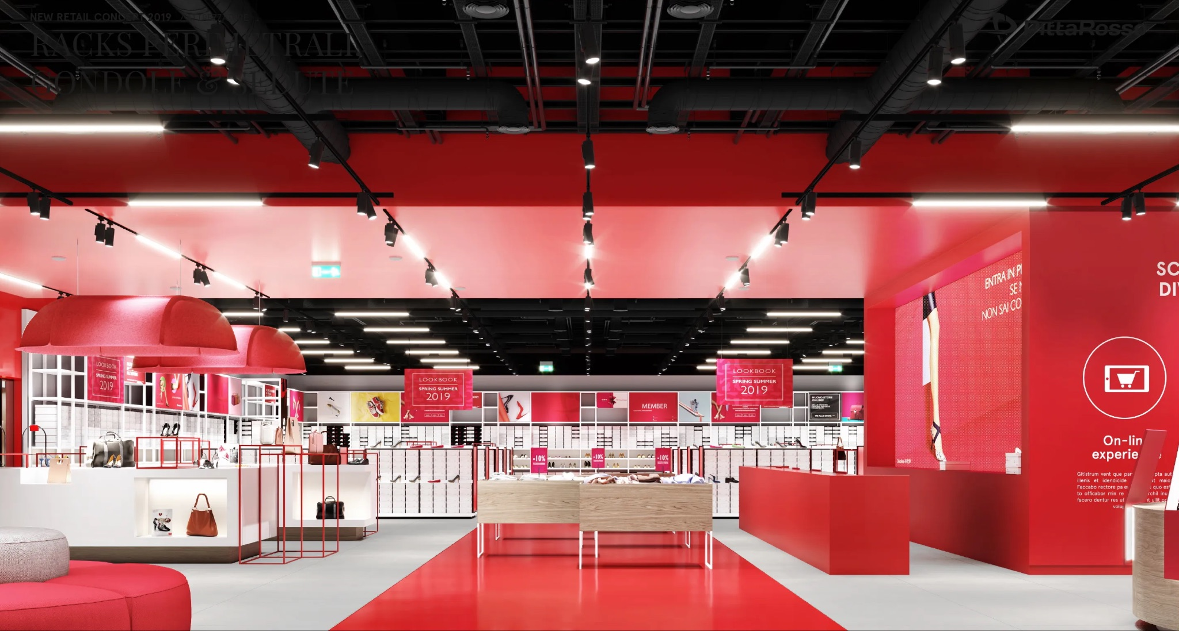
Team 3:
Hank Kataria, Tuyen Do, Nashwa Malik, Vedant, Sunny Khade, Matthew Joe

Slide 2
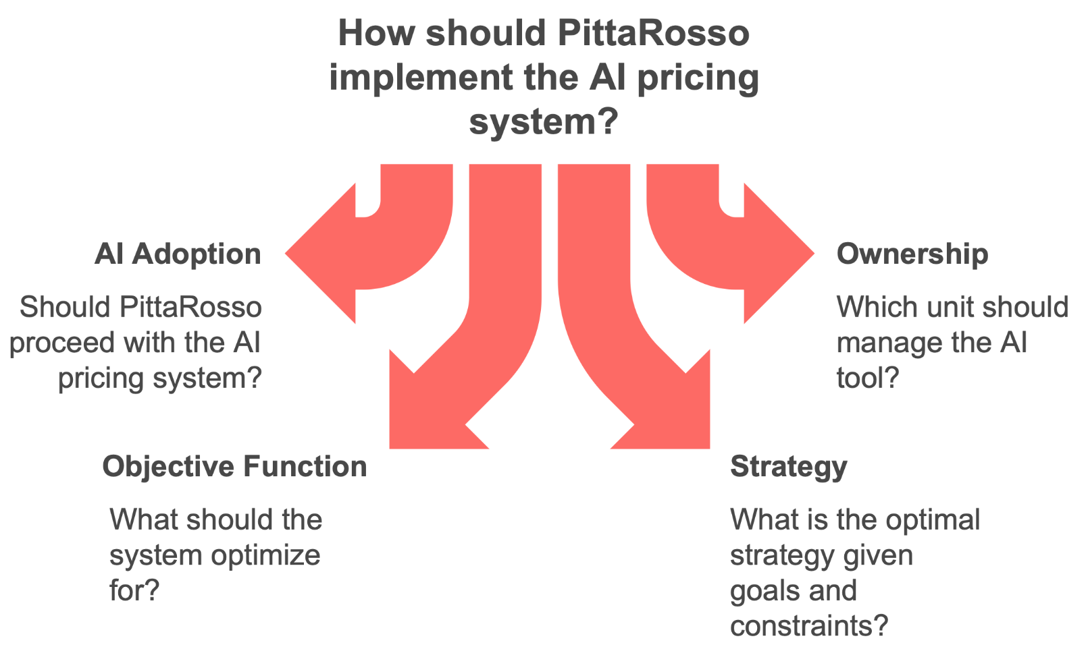
Overview
A little insight into PittaRosso:
Major Italian shoe retailer with 200+ stores and high inventory levels
CEO Marcello Pace initiated a turnaround in 2019 (store closures, assortment overhaul, brand repositioning)
Introduced AI tool via Evo Pricing to optimize markdowns and promotions

Slide 3

Adoption of AI Tool
Strategic adoption is essential for efficiency and growth
Why it’s a Good Idea:
Automates pricing across 200 stores and 39,000+ SKUs
Reduces aged inventory through SKU-specific markdowns
Aligns promotions with real-time demand and consumer behavior
Enhances marketing ROI by integrating top and bottom funnel insights
Risks & Mitigation:
Internal resistance → Cross-functional training + phased implementation
Unexpected AI recommendations → Run controlled pilots and calibrate
Notes:
Sunny

Slide 4
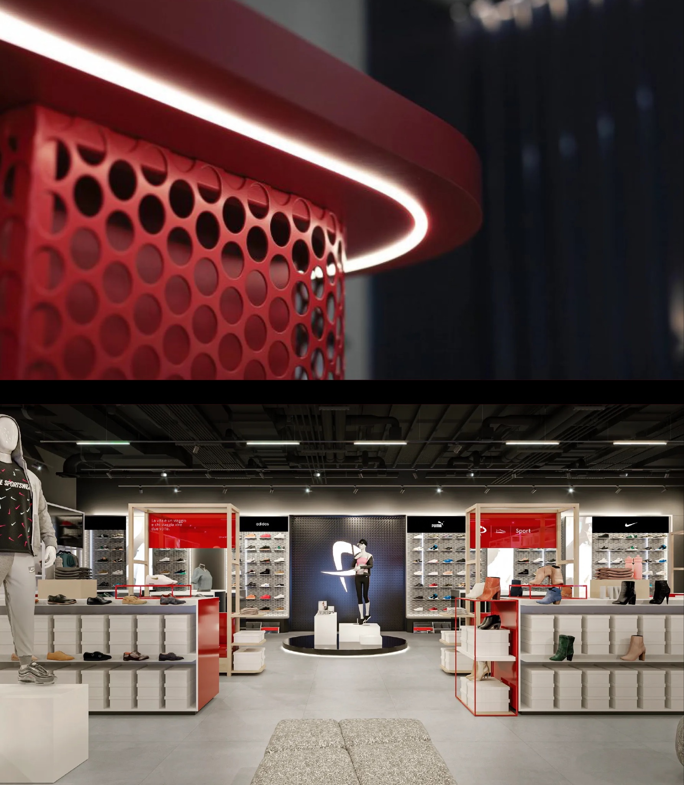
AI Tool Owner
Designated Owner: Valentina Labate – Head of Merchandise Planning & Allocation
Why Labate’s Team:
Oversees pricing, assortment, and inventory – all inputs to the AI
Already leading system rollout and alignment with vendor (Evo Pricing)
Trusted by CEO; has deep merchandising experience
Governance Structure:
Cross-functional steering group with:
Finance (margins/cash flow)
Buying (category insights)
Marketing (campaign alignment)
IT (data accuracy + integration)

Slide 5
Objective Function
Objective Function Recommendation:
Maximize a balanced mix of Sell-Through, Margin, and Revenue
Formula: Objective = 0.4 × Sell-Through + 0.3 × Gross Margin + 0.3 × Revenue
Why this Mix:
Sell-through → Clears aging inventory, improves cash flow
Margin → Maintains profitability in discount-heavy environment
Revenue → Supports refinancing and liquidity targets
Next Step: Adjust weights each season to reflect strategic priorities
Notes:
Sunny

Slide 6
Recommended Strategy
Markdown Strategy
Broad Promotions
Online Marketing Spend
Accelerate inventory turnover by targeting low-performing SKUs with strategic discounts.
Drive volume and urgency through limited-time offers aligned with seasonal shifts.
Engage high-intent customers through personalized, cost-effective digital outreach.
Focus on older and seasonal summer SKUs with low sell-through and high inventory.
Apply 20–30% markdowns selectively to boost sell-through.
Avoid discounting newer or high-margin items.
Launch “3 for 2” campaigns in late July to clear summer stock.
Target casual sandals and outdated designs.
Coordinate messaging across physical stores and online platforms.
Allocate €15,000–€20,000 to loyalty-targeted email and SMS campaigns.
A/B test content and timing for better performance.
Highlight active promotions like markdowns and 3x2 offers.

Slide 7
Recommended Strategy
Output Value (Cell E12)
E12 Result:
Reflects the optimized financial outcome based on AI-driven recommendations.
Likely Outcome:
Higher than traditional methods, combining markdowns, promotions, and online marketing for improved results.

Slide 8
Recommended Strategy
Why This is the Best Strategy?
Balanced Approach • Maximizes revenue • Maintains healthy margins • Reduces old inventory stock
AI-Driven Precision • SKU-specific markdowns and targeted promotions • Replaces broad, inefficient discounts
Inventory Health • Boosts sell-through rates • Clears aging stock, creating space for trendy collections
Customer Engagement • Targeted online marketing & loyalty programs • Increased store traffic and conversions

Slide 9
Other Recommendations
Foster Change Management and Cultural Acceptance
Implement training, workshops, and clear communication to overcome internal resistance and foster trust in the AI system.
Designate champions in merchandising and marketing to drive adoption and ensure alignment.
Improve Data Quality and System Calibration
Enhance data collection on customer preferences, sales trends, and promotions to ensure the AI tool delivers accurate and actionable insights.
Regularly calibrate the system to align with real-world dynamics and evolving market conditions.
Optimize Inventory and Supply Chain
Transition to dynamic, demand-driven inventory allocation instead of static, uniform distributions across stores. Work closely with suppliers to create flexible replenishment models that minimize excess stock and improve sell-through rates.

Slide 10
Thank You!

